Slide 1




Web Programming Framework
Topic 5:
Another Queries as a Basis for Creating Report
WEEK 05 Informatics Engineering
Universitas Surabaya
Informatics Engineering | Universitas Surabaya

Slide 2
Outline
1
2
3
4
5
Query Raw, Query Builder and Eloquent Query
Eloquent Relationship
Sub-Query
Query Inside Controller and Routing
Query for Reporting
Informatics Engineering | Universitas Surabaya

Slide 3
Raw Queries
Every Query technique, whether Query Builder or Eloquent Model, can accommodate various SQL syntaxes for data filtering, data aggregation, joining between data, data grouping, and data sorting
select * from users where name=‘andi’ and password=‘andi’ 🡺 Filter
select count(*) from users where name LIKE ‘%andi%’ 🡺 Agregation & Filter
select places.name, count(places.id) from places left join types on types.id = places.id group by places.id order by places.id desc 🡺 Agregation, Join, Group & Sort Data
Informatics Engineering | Universitas Surabaya

Slide 4
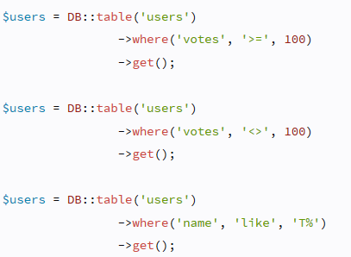
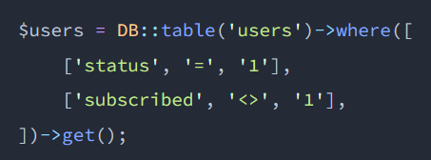
Example of Filter Data
Select * from users where status = 1 AND subscribed <> 1
https://laravel.com/docs/10.x/queries#where-clauses
Informatics Engineering | Universitas Surabaya

Slide 5
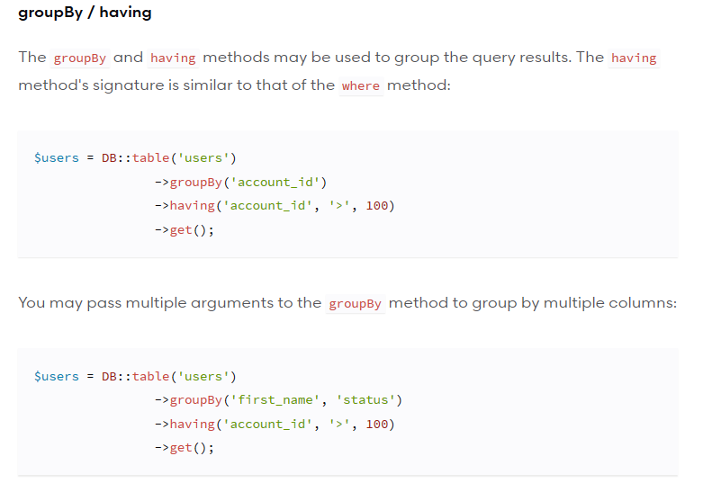
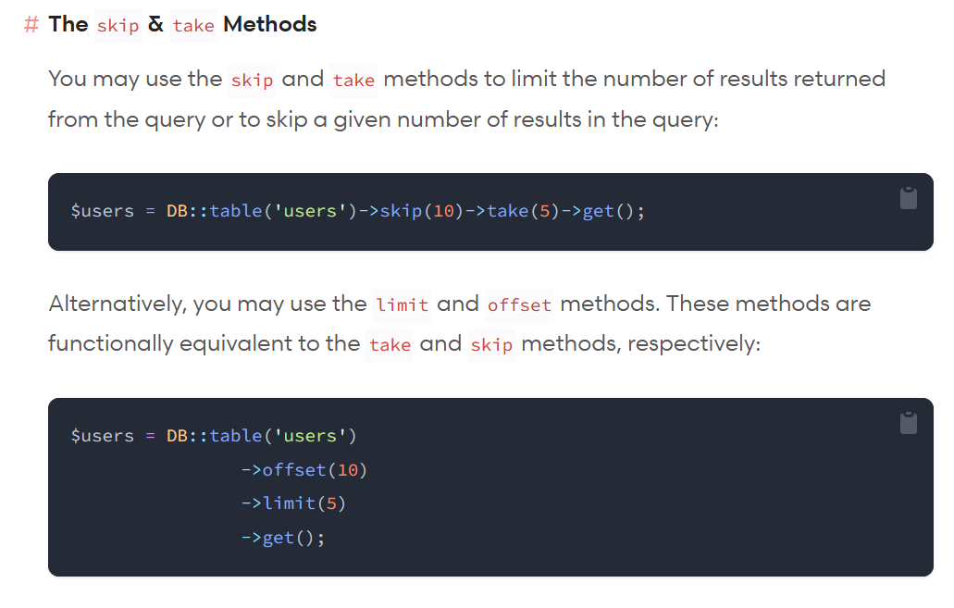
Example of Data Group / Limit Data
https://laravel.com/docs/10.x/queries#grouping
Informatics Engineering | Universitas Surabaya

Slide 6
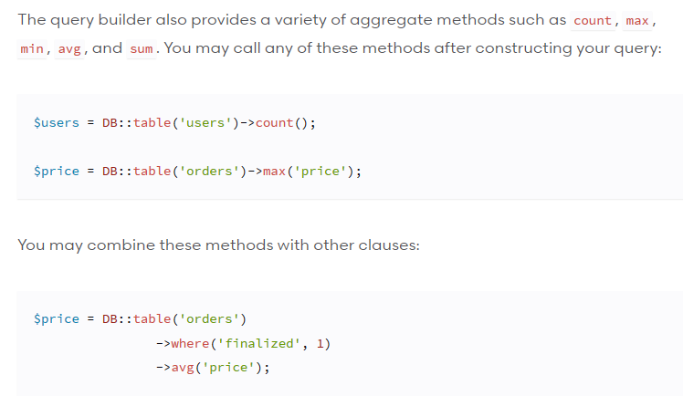
Example of Data Aggregation
Select count(*) from users;
Select max(price) from orders;
Select avg(price) from orders
where finalized = 1;
https://laravel.com/docs/10.x/queries#aggregates
Informatics Engineering | Universitas Surabaya

Slide 7
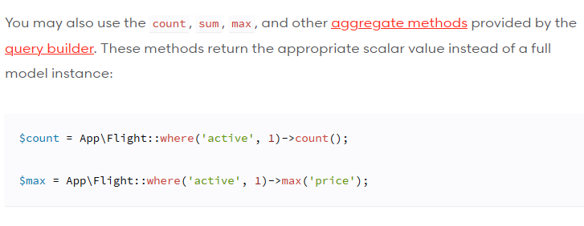
Aggregation with Eloquent Model
https://laravel.com/docs/10.x/queries#aggregates
Informatics Engineering | Universitas Surabaya

Slide 8
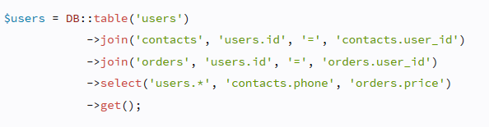
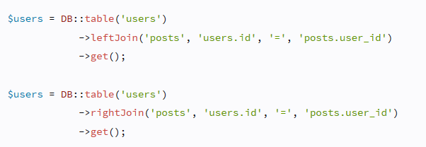
Example of Joining Data
select users.*, contacts.phone, orders.price
from users
inner join contacts on users.id=contacts.user_id
inner join orders on users.id = orders.user_id
select *
from users
left join posts on users.id=posts_user_id
select *
from users
right join posts on users.id=posts_user_id
https://laravel.com/docs/10.x/queries#joins
Informatics Engineering | Universitas Surabaya

Slide 9
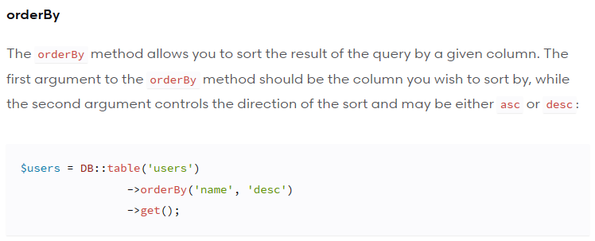
Example of Sorting Data
select *
from users
order by name DESC
Informatics Engineering | Universitas Surabaya

Slide 10
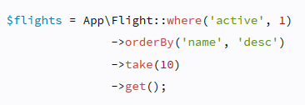
Query with Eloquent Model
When using Eloquent ORM(Model), Laravel provides various kinds of helpers or functions that are used. The syntax is similar to QueryBuilder.
Select *
from flights
where active = 1
order by name DESC
LIMIT 10;
Informatics Engineering | Universitas Surabaya

Slide 11
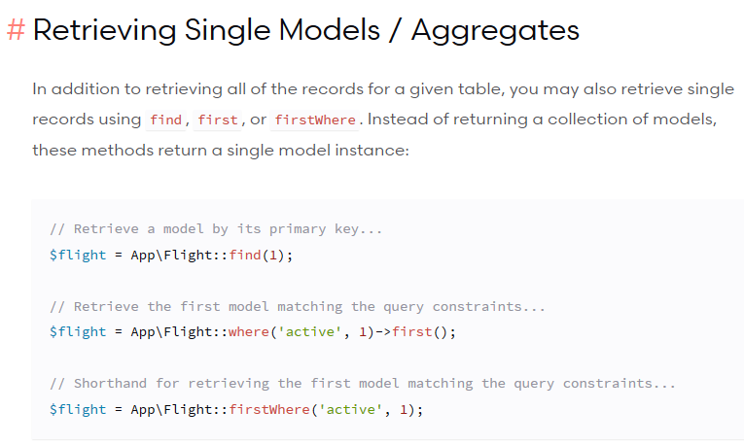
Eloquent : Retrieve Only Single Records
Informatics Engineering | Universitas Surabaya

Slide 12
Query with Raw Statement
The concept of Query using RAW method either with DB or Model has an identical way, namely with the select syntax. Inside the select, there is a string that contains the query.
You can use Prepared Statement concept in PHP (similar like in C# or Java)
Informatics Engineering | Universitas Surabaya

Slide 13
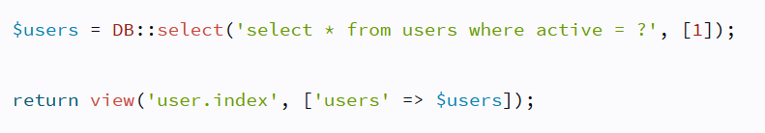
Prepared Statement
This syntax is similar to “select * from active users = 1”
but stated in more secure form of query, prepared statements also check data types which can help prevent SQL injection attacks.
Informatics Engineering | Universitas Surabaya

Slide 14
Sub-Query
Informatics Engineering | Universitas Surabaya

Slide 15
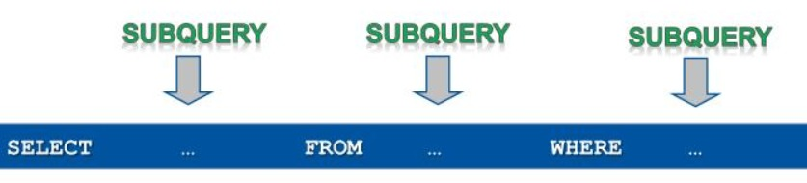
Prepared Statement
Remember about Sub-Query Syntax ?
There are 3 types of Sub-Query :
‘select clause’,
‘from clause’
‘where clause’
Informatics Engineering | Universitas Surabaya

Slide 16
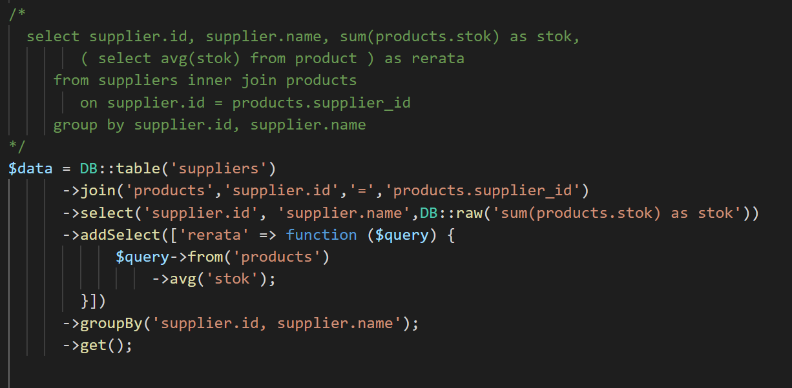
SubQuery: Select Clause
Sample Case :
show all Supplier ID and Name, number of stock that is already supplied and show the average number of stock from all supplier
Informatics Engineering | Universitas Surabaya

Slide 17
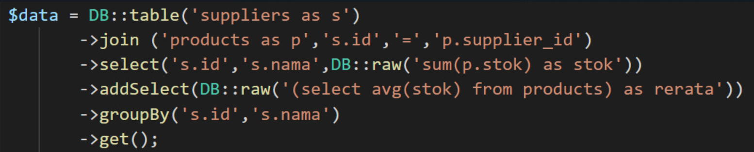
Another Solution with DB::raw()
Informatics Engineering | Universitas Surabaya

Slide 18
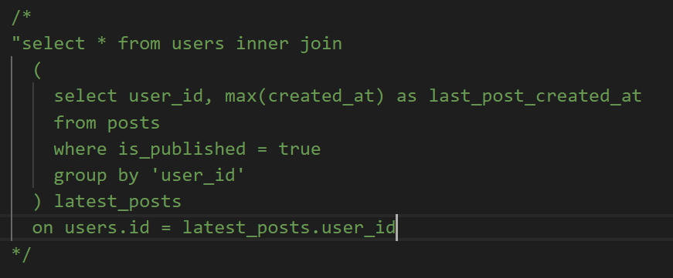
SubQuery: From Clause
Sample Case :
Show all User Data and the user’s latest post from each user that already published
Informatics Engineering | Universitas Surabaya

Slide 19
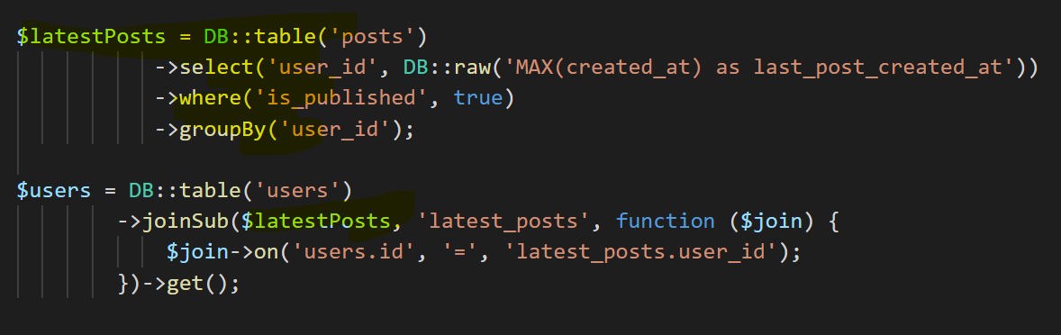
Query Builder: From Clause
$latestPosts is a query statement to the latest post for each user.
Informatics Engineering | Universitas Surabaya

Slide 20
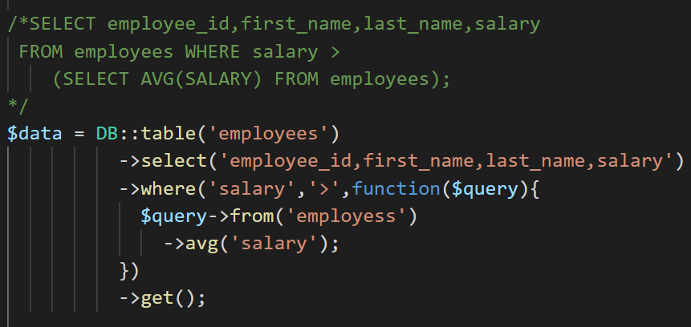
SubQuery: Where Clause with DB Table()
Sample Case :
show id, the full name of employee, and salary of the employee that has a salary above the average of all salaries in this company
Informatics Engineering | Universitas Surabaya

Slide 21
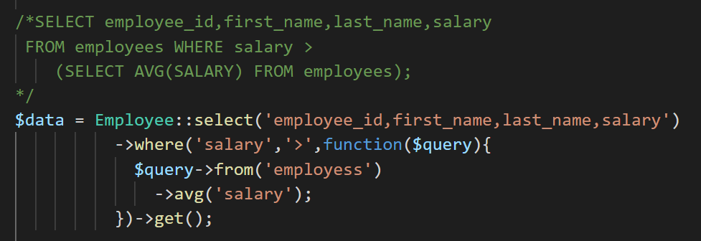
SubQuery: Where Clause with Eloquent
Sample Case :
show id, the full name of employee, and salary of the employee that has a salary above the average of all salaries in this company
Informatics Engineering | Universitas Surabaya

Slide 22
Eloquent Relationship Case : Post and Comment
Informatics Engineering | Universitas Surabaya

Slide 23
Eloquent Relationship
One of the benefits of using the Eloquent Model is the simplification of your Query statements.
To realize the benefit, the developer must assign the `relationship` in the early stage of development (after the creation of the model or after changes to the table structure).
There are 2 types of basic relationship:
One-to-many (similar with many-to-one in implementation phase)
Many-to-Many
This implementation is inside of each Model Class.
Note:
You should create a ModelClass first with
Example: php artisan make:model Product
Informatics Engineering | Universitas Surabaya

Slide 24
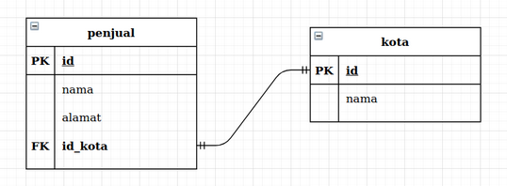

One to Many : hasMany
One-to-many
There are 2 syntaxes:
`hasMany` keyword
`belongsTo` keyword
If you have a custom name of Identifier (ID/Primary Key) or Foreign Key(FK) columns, You may also override the foreign and local keys by passing additional arguments to the hasMany.
As an example below, the `kota`, `penjual` table, and `id_kota` column isn’t a standard name of Laravel Eloquent Model. We should define it in the following way(use overriding if necessary).
Inside the Kota Class
Class Kota extends Model {
protected $table = ‘kota’;
public function penjuals() {
return $this->hasMany(Penjual::class, ‘id_kota’, ‘id’);
}
}
Pay attention to the position of the columns (red and green), don't get them mixed up !
Informatics Engineering | Universitas Surabaya

Slide 25
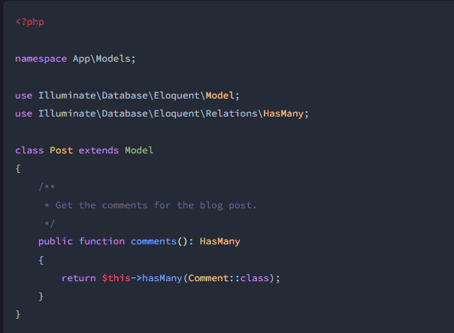
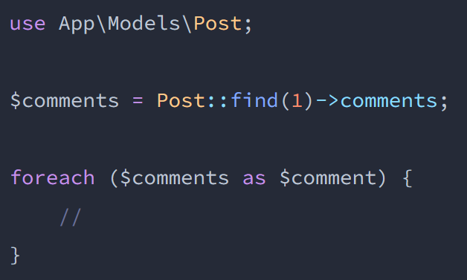
One to Many : hasMany (2)
The usage of Eloquent’s `hasMany` statement is the same as the picture above.
This syntax can implement inside the Controller.
Define or import ModelClass first
Call your Model and call the function without a bracket ()
$comments will assign with list of Comment based on Post that has id=1
Example : `hasMany` keyword
Informatics Engineering | Universitas Surabaya

Slide 26
One to Many : belongsTo
One-to-many
There are 2 syntaxes:
`hasMany` keyword
`belongsTo` keyword
If you have a custom name of Identifier (ID/Primary Key) or Foreign Key(FK) columns, You may also override the foreign and local keys by passing additional arguments to the belongsTo.
As an example below, the `kota`, `penjual` table, and `id_kota` column isn’t a standard name of Laravel Eloquent Model. We should define it in the following way(use overriding if necessary).
Inside the Penjual Class
Class Penjual extends Model {
protected $table = ‘penjual’;
public function kota() {
return $this->belongsTo(Kota::class, ‘id_kota’);
}
}
Pay attention to the position of the columns (red and green), don't get them mixed up !
Informatics Engineering | Universitas Surabaya

Slide 27
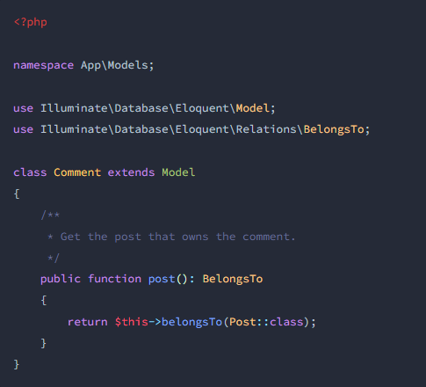
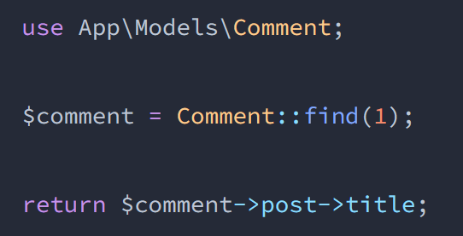
One to Many : belongsTo (2)
The usage of Eloquent’s `belongsTo` statement is the same as the picture above.
This syntax can implement inside the Controller.
Define or import ModelClass first
$comment has a Post object that has id=1
You can get the title of post based on number #3, you can type with this format:
$comment->your_function>your_field_of_object
Example : `belongsTo` keyword
Informatics Engineering | Universitas Surabaya

Slide 28
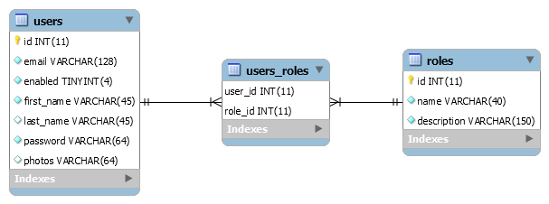
Eloquent Relationship : Many to Many
This example is the many-to-many scenario with the standard name of Laravel Eloquent Model
Criteria:
Each tables use plural nouns.
Intermediated table use singular noun of each many-to-many and order with alphabetic
Informatics Engineering | Universitas Surabaya

Slide 29
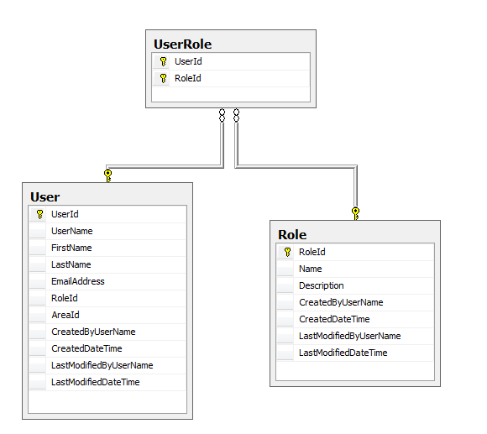
Many to Many : hasMany
There are 1 syntaxes: `belongsToMany` keyword
If you have a custom name of Identifier (ID/Primary key) and Foreign_key, You may also override the foreign and local keys by passing additional arguments to the belongsToMany.
As an example, the `user`, `role`, `UserRole` table, and `UserId`, `RoleId` column isn’t a standard name of Laravel Eloquent Model. You must define with
Class User extends Model {
protected $table = ‘User’;
public function roles() {
return $this->belongsToMany(Role::class,
‘UserRole’,
`UserId`,`RoleId`);
}
}
Class Role extends Model {
protected $table = ‘Role’;
public function users() {
return $this->belongsToMany(User::class,
‘UserRole’,
`RoleId`,`UserId`);
}
}
Informatics Engineering | Universitas Surabaya

Slide 30
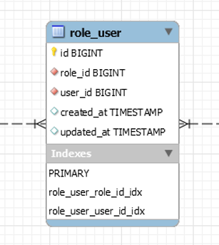
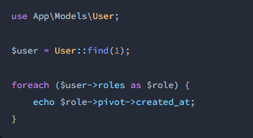
Many to Many : Get Value
In this example, we want to get the data creation time of role_user data.
So, we must get value of `created_at` from specific role
You can use ->pivot->
Example
Retrieving creation time data from role_user table for user with user_id=1 and role_id=2
Informatics Engineering | Universitas Surabaya

Slide 31
#1 Practice Our Case Study
Informatics Engineering | Universitas Surabaya

Slide 32
Assign your Food with Category
Based on our case study, we know that Food as one category but one category can have multiple variant of food.
So the Data Design shown as follow:
Categories ID (PK)
Name
. . . .
Food ID (PK)
Name of Food
…..
category_id (FK)
Informatics Engineering | Universitas Surabaya

Slide 33
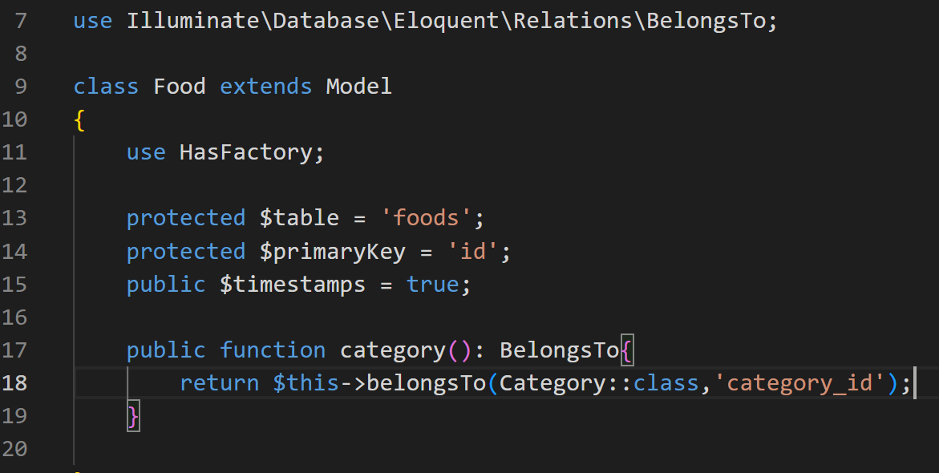
One To Many : belongsTo
Discussion in your class:
Can you explain why this example uses `belongsTo` and why does the example decide to give ‘category’ as function name?
Informatics Engineering | Universitas Surabaya

Slide 34
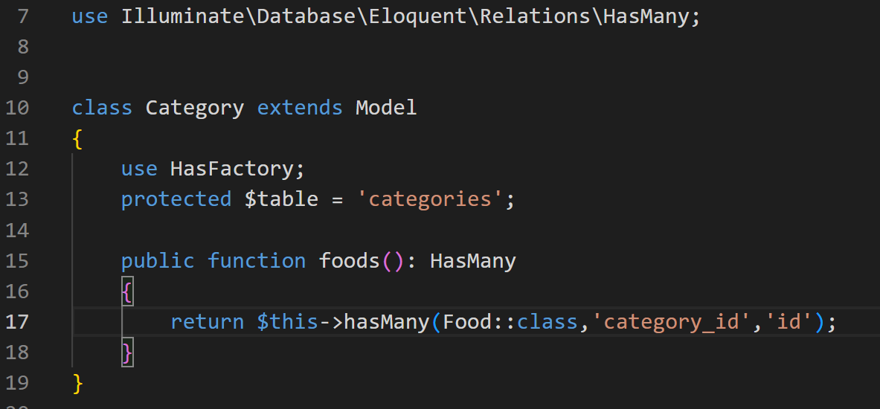
One To Many : hasMany
Discussion in your class:
Can you explain why this example uses `hasMany` and use “foods” in function name?
Informatics Engineering | Universitas Surabaya

Slide 35
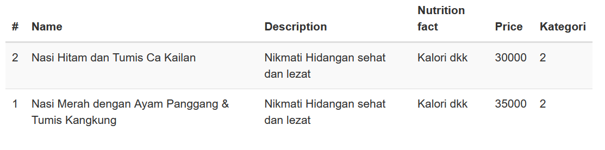
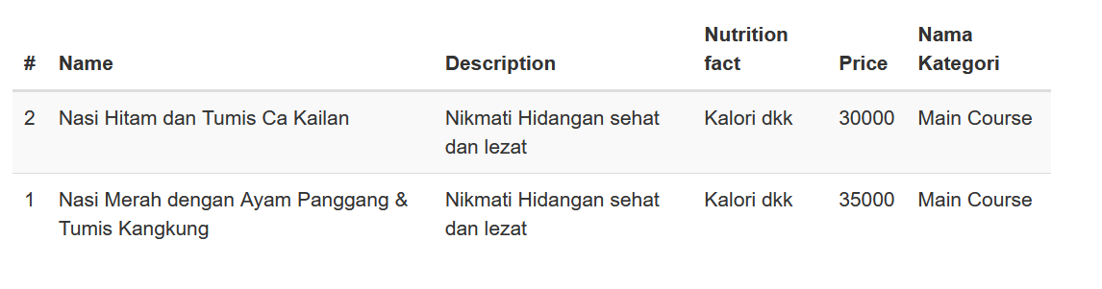
Try your current project → List of Food
Change your id_category with name category with Eloquent Model

Slide 36
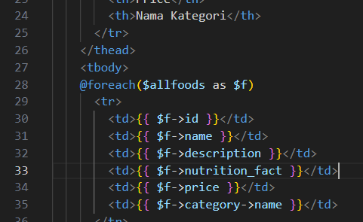
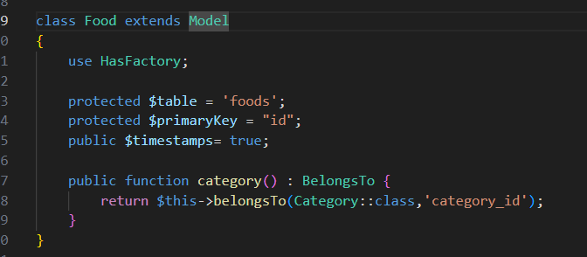
Your “Food.index” view, add one column and modify your “category_id” based on Your Model

Slide 37
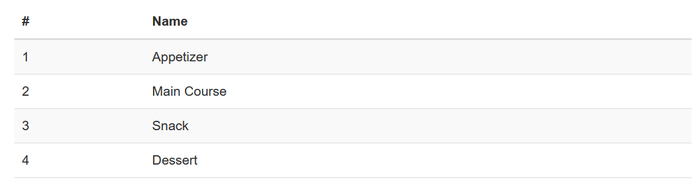
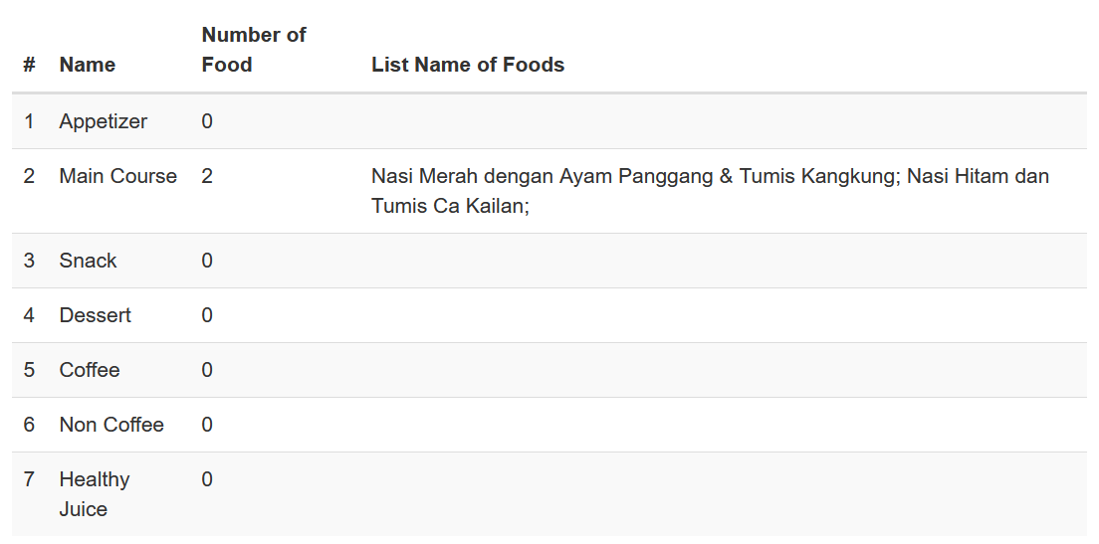
Try your current project → List of Category
Add new Column for Number of Foods and List name of Foods

Slide 38
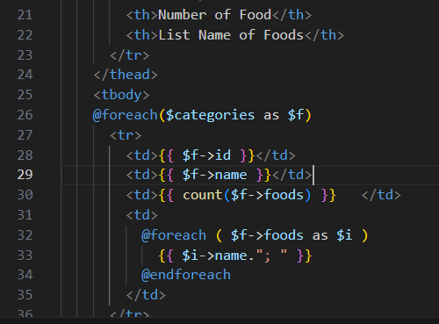
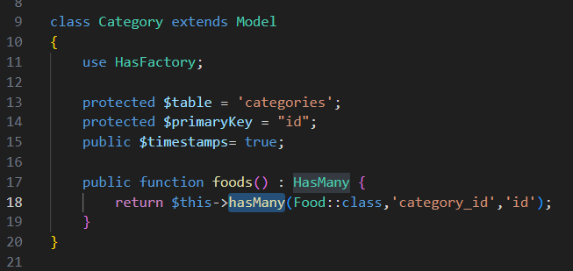

Slide 39
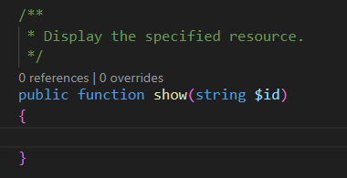
Show specific Food : Try it !
Please open your FoodController !
If you don’t have Food Controller, you can run this command:
php artisan make:controller FoodController --resource
show() function inside your Controller is used to inform the details of your object (in this case is Product object)
show() function always required 1 parameter ($id) that represented the value of ID product.
With php artisan route:list you can see the required parameter routing and the route name below.
Informatics Engineering | Universitas Surabaya

Slide 40
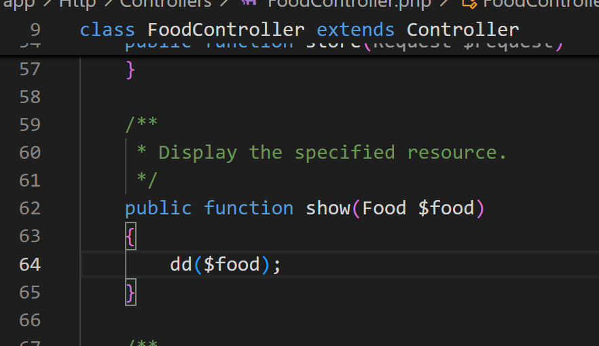
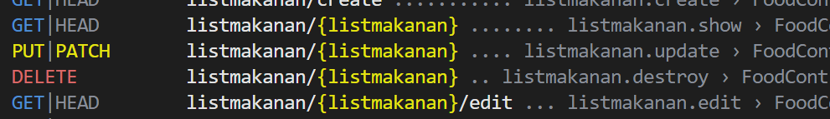
Debugging
using dd(dump and die)
DD will ‘dump’ your query result and make the apps temporarily ‘die’.
Insert dd function to inspect the specific food data
Use route list to know the URL format

Slide 41
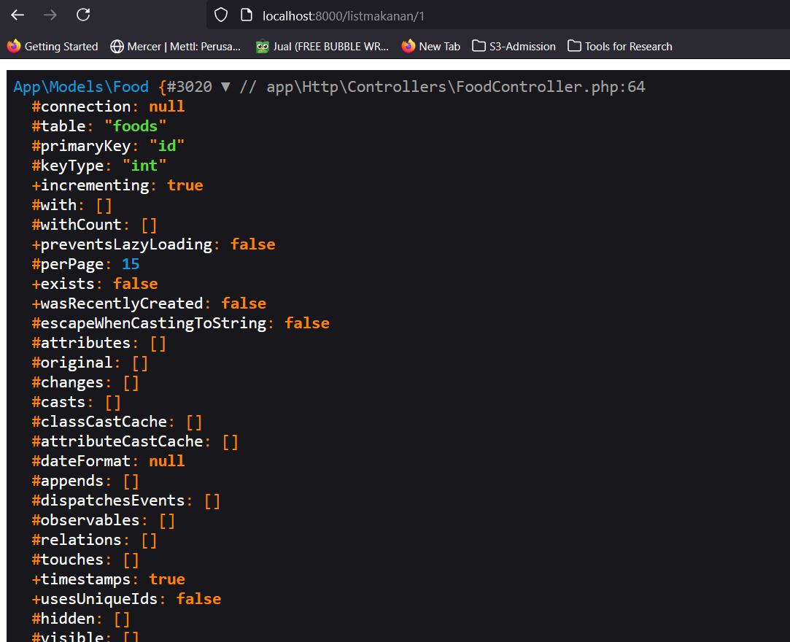
There is no data inside attributes

Slide 42
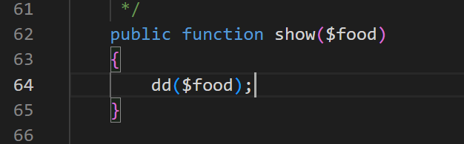
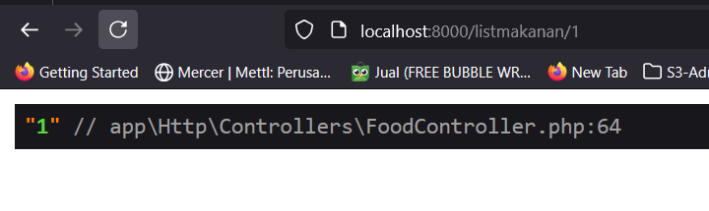
Remove Model inside parameter function

Slide 43
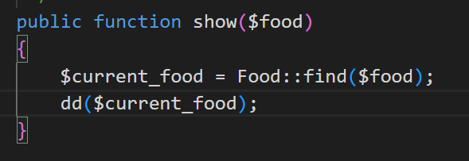
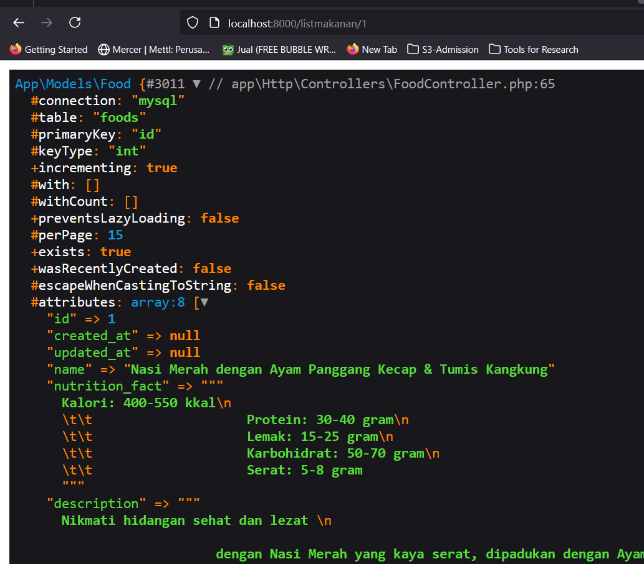

Slide 44
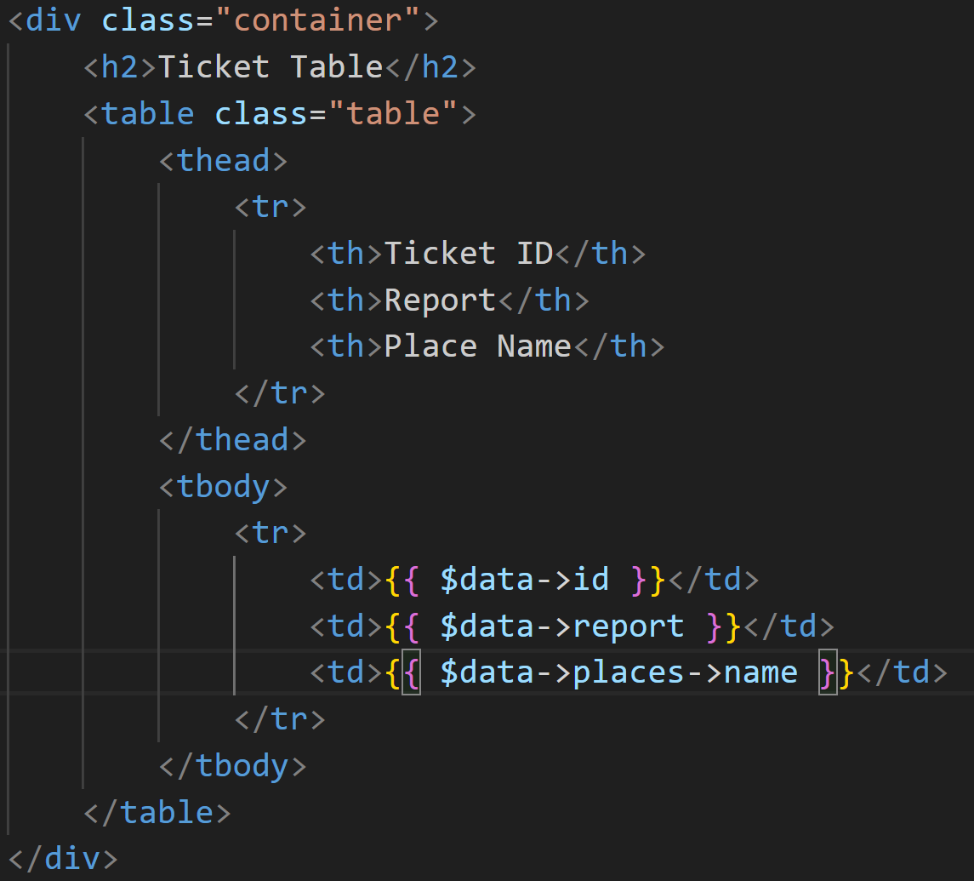
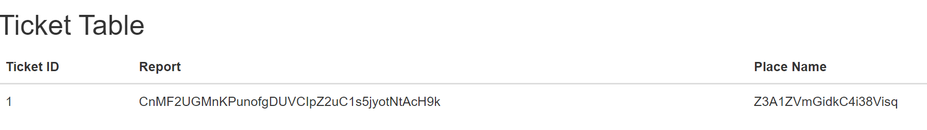
Debugging using dd(dump and die)
We can see the `Magic` statement
$data is the variable sent from controller
->places is function of Eloquent Relationship in the Places Model.
->name is an attributed based on our database
Example : http://127.0.0.1:8000/tickets/show/1
Informatics Engineering | Universitas Surabaya

Slide 45
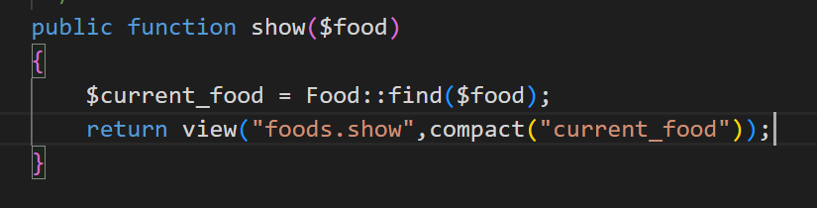
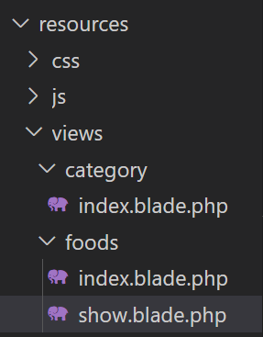
Show Implementation
Don’t forget to create blade file in resource/view/product directory, name it show.blade.php
Ensure the route (show) passes with id parameter
Informatics Engineering | Universitas Surabaya

Slide 46


Construction View
Use Boostrap View Template. For catalog or list of data, you can use this example:
https://www.w3schools.com/bootstrap4/bootstrap_cards.asp
https://mdbootstrap.com/docs/standard/components/cards/
https://mdbootstrap.com/docs/standard/extended/gallery/
https://getbootstrap.com/docs/4.0/examples/album/
For the detail page, we recommend use this:
https://bootstrapexamples.com/@andreas-muller/product-details-page
Informatics Engineering | Universitas Surabaya

Slide 47


Go to example of Boostrap (https://www.w3schools.com/bootstrap4/tryit.asp?filename=trybs_card&stacked=h)
Construct HTML, Import CSS/JS from Boostrap
Use Basic Card first based on the example
Run project first
Change the body with another example (https://getbootstrap.com/docs/4.0/examples/album/ )

Slide 48


Slide 49


Make link from your list to your detail data food

Slide 50
Reports
Informatics Engineering | Universitas Surabaya

Slide 51
Reports in an Information System
Reports in an information system are the result of analysis of data in the database.
Data analysis can use previous query concepts such as
Data Aggregation
Join Data
Sort data
Filter data
Laravel gives you the freedom to create custom reporting on URLs.
Informatics Engineering | Universitas Surabaya

Slide 52

Create Custom URL
Please re-open our Routing Material (from Week 1 or Week 2) https://laravel.com/docs/10.x/routing#basic-routing
Form Report usually uses the GET HTTP method because the report function predominately retrieves data from the database and displays it in the view. So Routing (in routes/web.php) which we will often use has a syntax format
Informatics Engineering | Universitas Surabaya

Slide 53
#2 Practice
Informatics Engineering | Universitas Surabaya

Slide 54
Practice #2
Please create a new page for showing category list with total foods.
Hint :
Add custom URL in web.php (url : BASE_URL/category/showTotalFoods
Create function in CategoryController
In query, use count() to get total category
If there is no food in specific category, system will set total food = 0
Create view with name totalfood.blade.php inside category folder
Informatics Engineering | Universitas Surabaya

Slide 55
Thank You!
Informatics Engineering | Universitas Surabaya

